Slide 1
Back to school night
Contact Information:
Ms. Rachel Nulty
rnulty@cbsd.org
Room – C307
Phone – 267.893.3000
Sociology
Social Studies Elective
9Weeks

Slide 2
What do we study?
Sociology is a nine-week elective which is designed to introduce students to the basic concepts, principles, and methods central to the study of human society.
Sociology involves discussion and reflection about many sometimes controversial and sensitive topics. As such, it is expected that students engage deeply with the material and respectfully listen to each other’s opinions and involve themselves in fruitful class discussions. All discussions and opinions should be based on facts from reputable sources.
A variety of sociological perspectives will be applied throughout this course in order to enable students to more effectively analyze and evaluate human behavior and social phenomena.
This course should enhance the student’s sociological imagination through discussion, participation in activities that explore the connections between individual actions and the larger social world and the collection, analysis and interpretation of data.

Slide 3
Units
These are the potential topics that we will study this marking period.
Unit 1 - Introduction to Sociology
Unit 2 – Culture and Social Interaction
Unit 3 – Socialization
Unit 4 - Social Stratification
Current Issues/Events

Slide 4
Textbook
Sociology in our Times – Diana Kendall
Supplementary video clips and readings will be provided throughout the course.

Slide 5
Canvas Pairing and Syllabus
If you are at BTSN – Canvas pairing directions are handed out. If you are home – please click - Link to Canvas Pairing Directions:
If you are at BTSN – the course syllabus is handed out. If you are home – please click: Course syllabus (also on front page of Canvas)

Slide 6
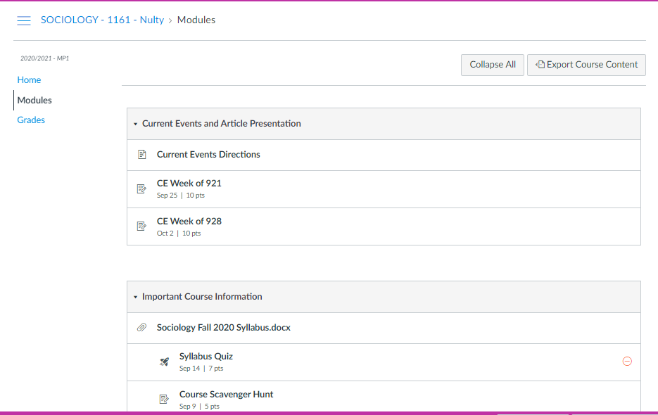
Modules

Slide 7
Grading and Assessment and Infinite Campus
All major projects and tests will be listed in the summative category and will be worth 90% of grade.
The formative category will contain all major classwork activities. It is worth 10% of grade.
There is another category called non-graded. This category does not contribute to the marking period or final grade. But this gives you important feedback about class/homework completion etc.
It is expected that students hand in work on time and that they check their grades on IC daily.

Slide 8
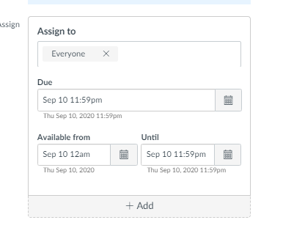
Assignment Submission
Canvas assignments have opening dates and end dates. If your child could not submit – it most likely means that they are handing it in late.
Either way, they should email at the time and include the assignment if there is some other technical issue. Work should be handed in on time.

Slide 9
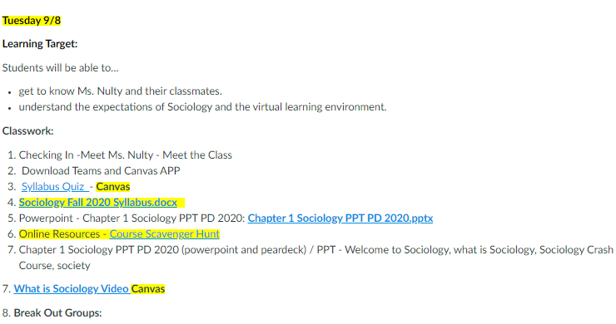
Daily Agenda -Canvas
The agenda for the day and week are available under Daily Activities in each unit.

Slide 10
Calendar on Canvas
All assignments for all classes are listed in Canvas calendar on the day it is due and the time due is also listed.

Slide 11
Assessments
There is a possibility of some tests in this class. Sometimes they are take-home tests, sometimes in class.
If there is a test, there will be a study guide available.

Slide 12
Students will be successful if they
make full use of Canvas – class materials, lecture notes, readings, agendas, and other resources will be regularly available.
complete all assignments before, and during, class.
study.
ask questions and actively participate.
are responsible. If you have been absent and missed work, find out what it was and make it up as soon as possible.
ask for help. Office hours are available every week.
collaborate. This is a 9-week course, get to know each other. You never know who might be able to help you out or who you may be able to help.

